Slide 1

Summer Community Engagement
July 9, 2024
Compassion – Accountability – Integrity – Respect

Slide 2
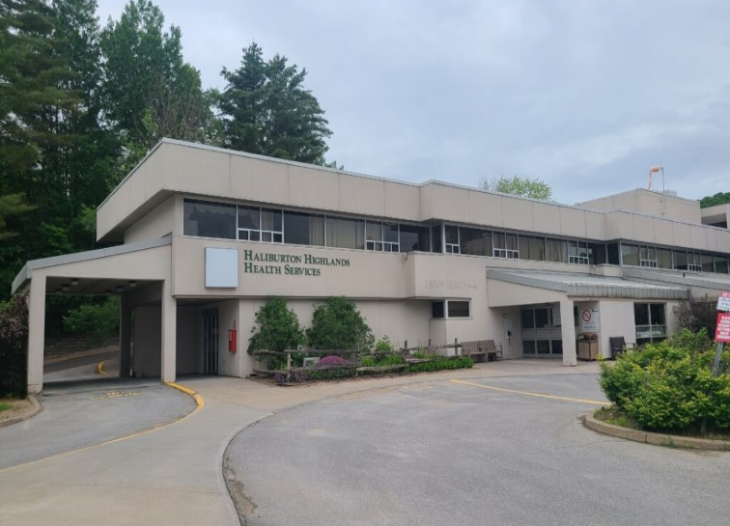

Summer Community Engagement
July 9, 2024
Compassion – Accountability – Integrity – Respect

Slide 3
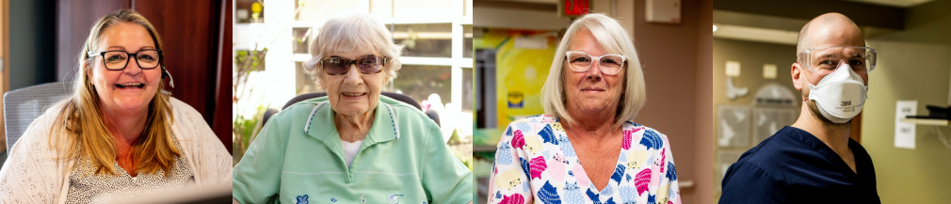
Summer Community Engagement
July 9, 2024
Compassion – Accountability – Integrity – Respect

Slide 4
Welcome
<<Insert name of presenter here>>

Slide 5
Land Acknowledgement

Slide 6
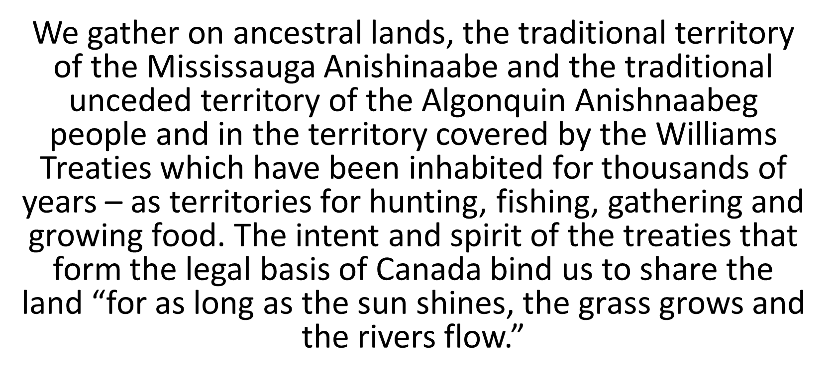
Highlands History

Slide 7
Agenda

Slide 8
<<Insert Slide Title Here>>
Provide a high-level list of your agenda items here,
and here,
and here.

Slide 9
<<Title slide for each agenda item>>
<<Insert name of presenter here>>

Slide 10
<<Insert Slide Title Here>>
<< Insert slide text here>>

Slide 11
<<Table Slide Title Here>>
<< Insert table slide text here>>

Slide 12
Tell me, I forget.
Show me, I remember.
Include me, I understand.
Chinese Proverb

Slide 13
Thank you!
Compassion – Accountability – Integrity – Respect

